Slide 1

Big Data for Healthcare:
Usage, Architecture and Technologies

Slide 2

Presenters
Pete Stiglich – Sr. Technical Architect
Over 20 years IT experience
Enterprise Data Architecture, Data Management, Data Modeling, Data Quality, DW/BI, MDM, Metadata Management, Data Quality, Database Administration (DBA)
President of DAMA Phoenix, writer, speaker, former editor Real World Decision Support, listed expert for SearchDataManagement – Data Warehousing and Data Modeling
Certified Data Management Professional (CDMP) and Certified Business Intelligence Professional (CBIP), both at master level
Email: Pete.Stiglich@Perficient.com
Phone: 602-284-0992
Twitter: @pstiglich
Blog: http://blogs.perficient.com/healthcare/blog/author/pstiglich/
Notes:
5/30/2012
2

Slide 3

Presenters
Hari Rajagopal – Sr. Solution Architect
Over 15 years IT experience
SOA solutions, Enterprise Service Bus technologies, Data Architecture, Algorithms
Presenter at conferences, Author and Blogger
IBM certified SOA solutions designer
Email: Hari.Rajagopal@Perficient.com
Phone: 303-517-9634
Notes:
5/30/2012
3

Slide 4


Key Takeaway Points
Big Data technologies represent a major paradigm shift – and is here to stay!
Big Data enables “all” the data to be leveraged for new insight– clinical notes, medical literature, OR videos, X-rays, consultation recordings, streaming medical device data, etc.
More intelligent enterprise – more efficient and prevalent advanced analytics (predictive data mining, text mining, etc.)
Big Data will affect application development and data management
Notes:
5/30/2012
4

Slide 5
Agenda
What is Big Data?
How Big Data can enable better healthcare
Types of Big Data processing
Key technologies
Impacts of Big Data on:
Application Development
Data Management
Q & A
Notes:
5/30/2012
5

Slide 6

What is Big Data?

Slide 7
What is “Big Data”
Datasets which are too large, grow too rapidly, or are too varied to handle using traditional techniques
Volume, Velocity, Variety
Volume – 100’s of TB’s, petabytes, and beyond
Velocity – e.g., machine generated data, medical devices, sensors
Variety – unstructured data, many formats, varying semantics
Not every data problem is a “Big Data” problem!!
Notes:
5/30/2012
7

Slide 8
MPP enables Big Data
100’s, 1,000’s of nodes
…
Scalability
Scalability
Cluster (homogenous) or Grid (heterogeneous)
SMP – Symmetric Multiprocessing
“Shared Everything”
CPU, memory, disk (SAN, NAS)
MPP – Massively Parallel Processing
“Shared Nothing”
Nodes do not share
CPU, memory, disk (DAS)
Notes:
5/30/2012
8
SAN – Storage Area Network – Makes storage appear to be locally attached devices – block level
NAS – Network Attached Storage – File level storage over the network. NFS, etc., used to share filesystems
DAS – Direct attached storage – MPP uses the disks on the nodes rather than sharing the disks

Slide 9
Cost Factor
Cost of storing and analyzing Big Data can be driven down by:
Low cost commodity hardware
Open source software
Public Cloud? Yes, But for really massive amounts of data with many accesses, may be cost prohibitive
Learning curve? You bet!
Notes:
5/30/2012
9
See http://www.slideshare.net/OpenLogic/top-10-lessonshadooptop-10-lessons-learned-from-deploying-hadoop-in-a-private-cloud for cost comparison private cloud to Amazon EC2 public cloud

Slide 10
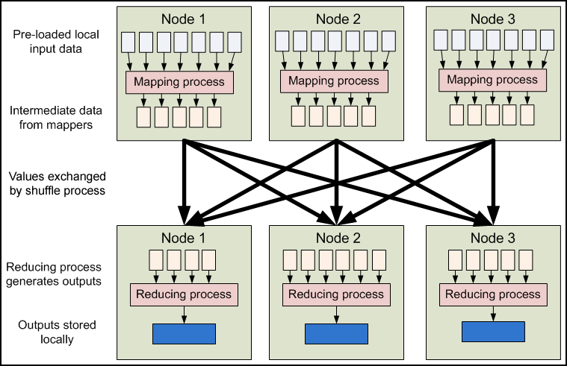
Hadoop / MapReduce
Hadoop and MapReduce – key Big Data technologies developed at Google, now open source
“Divide and conquer” approach
Highly fault tolerant – nodes are expected to fail
Every data block (by default) replicated on 3 nodes (is also rack aware)
MapReduce – component of Hadoop, programming framework for distributed processing
Not the only Big Data technology…
Notes:
5/30/2012
10

Slide 11
NoSQL
Stands for “Not only SQL” – really s/b “Not only Relational”
New(ish) paradigms for storing and retrieving data
Many Big Data platforms don’t use a RDBMS
Might take too long to setup / change
Problems with certain types of queries (e.g., social media, ragged hierarchies)
Key Types of NoSQL Data Stores
Key-Value Pair
Wide Column
Graph
Document
Object
XML
More than 100 non-relational NoSQL DB’s!!
Notes:
5/30/2012
11

Slide 12
How can “Big Data” improve Healthcare?

Slide 13
Healthcare “Big Data” opportunities
Examples of Big Data opportunities
Patient Monitoring – inpatient, ICU, ER, home health
Personalized Medicine
Population health management / ACO
Epidemiology
Keeping abreast of medical literature
Research
Many more…
Notes:
5/30/2012
13

Slide 14

Healthcare “Big Data” opportunities
Patient Monitoring
Big Data can enable Complex Event Processing (CEP) – dealing with multiple, large streams of data in real-time from medical devices, sensors, RFID, etc.
Proactively address risk, improve quality, improve processes, etc.
Data might not be persisted – Big Data can be used for distributed processing with the data located only in memory
Example – an HL7 A01 message (admit a patient) received for an inpatient visit – but no PV1 Assigned Patient Location received within X hours. Is the patient on a gurney in a hallway somewhere???
Example – home health sensor in a bed indicates patient hasn’t gotten out of bed for X number of hours
Notes:
5/30/2012
14
PV1 – Patient Visit segment

Slide 15
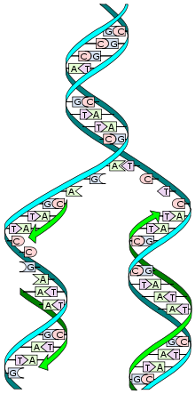

Healthcare “Big Data” opportunities
Personalized Medicine
Genomic, proteomic, and metabolic data is large, complex, and varied
Can have gigabytes of data for a single patient
Use case examples - protein footprints, gene expression
Difficult to use with a relational database, XML performance problematic
Use wide-column stores, graphs, key-value stores (or combinations) for better scalability and performance
Source: wikipedia
Notes:
5/30/2012
15
http://www.google.com/url?sa=t&rct=j&q=&esrc=s&frm=1&source=web&cd=2&sqi=2&ved=0CDoQFjAB&url=http%3A%2F%2Fciteseerx.ist.psu.edu%2Fviewdoc%2Fdownload%3Fdoi%3D10.1.1.97.1906%26rep%3Drep1%26type%3Dpdf&ei=f55zT-agPMHK2AWpk9XsDg&usg=AFQjCNF_Qy7Y_glGSvGf1w3DKqGHqNrZCA&sig2=ahAF8Dtaiv4oVQmxfbTHcA
Why is XML problematic – XML expands the size of the data by 5 due to the tags

Slide 16

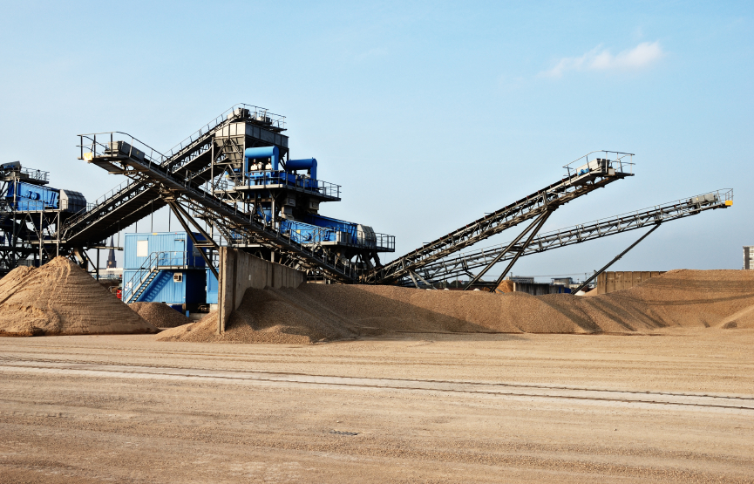
Healthcare “Big Data” opportunities
Population Management
Preventative care for ACO – micro-segmentation of patients
Identify most at risk patients – allocate resources wisely to help these patients (e.g., 1% of 100,000 patients had 30% of the costs)*
Reduce admits/re-admits, ER visits, etc.
Identify potential causes for infections, readmissions (e.g., which two materials when used together are correlated with high rates of infection)
Even with structured data, data mining can be time consuming – distributed processing can speed up data mining
* http://nyr.kr/L8o1Ag (New Yorker article)
Notes:
5/30/2012
16
“An accountable care organization (ACO) is a type of payment and delivery reform model that seeks to tie provider reimbursements to quality metrics and reductions in the total cost of care for an assigned population of patients” Wikipedia.org

Slide 17
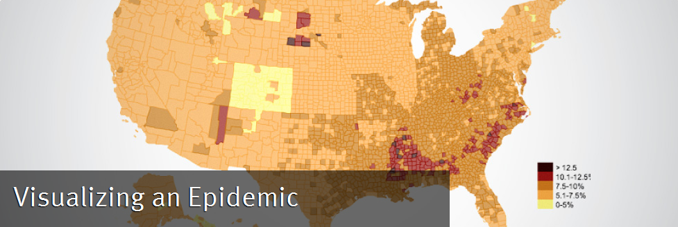
Healthcare “Big Data” opportunities
Epidemiology
Analysis of patterns and trends in health issues across a geography
Tracking of the spread of disease based on streaming data
Visualization of global outbreaks enabling the determination of ‘source’ of infection

Slide 18


Healthcare “Big Data” opportunities
Unstructured data analysis
Most data (80%) resides in unstructured or semi-structured sources – and a wealth of information might be gleaned
One company allows dermatology patients to upload pictures on a regular basis to analyze moles in an automated fashion to check for melanoma based on redness, asymmetry, thickness, etc.
A lot of information contained in clinical notes, but hard to extract
Providers can’t keep abreast of medical literature – even specialists! Use Big Data and Semantic Web technologies to identify highly relevant literature
Sentiment analysis – using surveys, social media
Etc…
Notes:
5/30/2012
18

Slide 19
Poll
What Healthcare Big Data use case do you see as being most important for your organization?
Patient Monitoring
Personalized Medicine
Population Management (e.g., for ACO)
Epidemiology
More effective use of medical literature
Medical research
Unstructured data analysis
Quality Improvement
Other

Slide 20
Types of Big Data processing

Slide 21
Analytics
Big Data ideal for experimental / discovery analytics
Faster setup, data quality not as critical
Enables Data Scientists to formulate and investigate hypotheses more rapidly, with less expense
May discover useful knowledge . . . or not
Fail faster – so as to move on to the next hypothesis !
Notes:
5/30/2012
21

Slide 22
Unstructured Data Mining
Big Data can make mining unstructured sources(text, audio, video, image) more prevalent - more cost effective, with better performance
E.g., extract structured information, categorize documents, analyze shapes, coloration, how long was a video viewed, etc.
Text Mining capabilities
Entity Extraction – extracting names, locations, dates, products, diseases, Rx, conditions, etc., from text
Topic Tracking – track information of interest to a user
Categorization – categorize a document based on wordcounts/synonyms, etc.
Clustering – grouping similar documents
Concept Linking – related documents based on shared concepts
Question Answering – try to find best answer based on user’s environment
Notes:
5/30/2012
22

Slide 23


Data Mining
Can enable much faster data mining
Can bypass some setup and modeling effort
Data Mining is “the automatic or semi-automatic analysis of large quantities of data to extract previously unknown interesting patterns” Wikipedia
Examples of data mining:
Association analysis - e.g., which 2 or 3 materials when used together are correlated with a high degree of infection
Cluster analysis – e.g., patient micro-segmentation
Anomaly / Outlier Detection –e.g., network breaches
Text
Text Mining
Other use cases
Entity Extraction
Structured Data
Data Mining
Something
Interesting?
Notes:
5/30/2012
23

Slide 24
Transaction Processing
Some Big Data platforms can be used for some types of transaction processing
Where performance is more important than consistency e.g., a Facebook user updating his/her status
More on this later…
Notes:
5/30/2012
24

Slide 25
Poll
What type of Big Data use case would be most beneficial for your client?
Complex Event Processing (using massive/numerous streams of real-time data)
Unstructured Data Analysis
Predictive Data Mining
Transaction Processing (where performance more important than consistency)

Slide 26
Big Data Architecture and Key Technologies

Slide 27
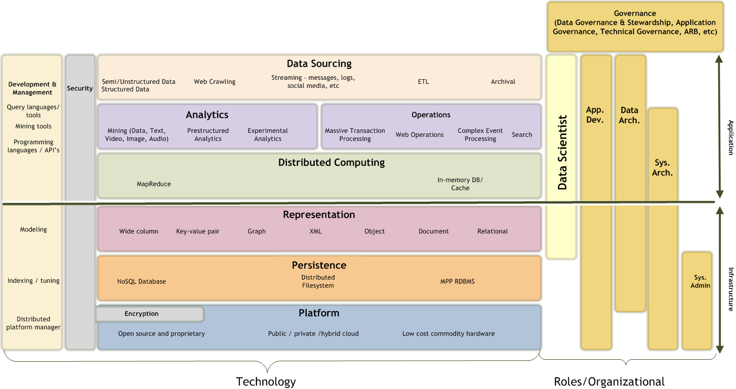
Big Data Stack
Notes:
5/30/2012
27

Slide 28





Hadoop
Used for batch processing – inserts/appends only – no updates
Single master – works across many nodes, but only a single data center
Key components
HDFS – Hadoop Distributed File System
MapReduce – Distributes data in key value pairs across nodes, parallel processing, summarize results
Hbase – database built on top of Hadoop (with interactive capabilities)
Hive – SQL like query tool (converts to MapReduce)
Pig – Higher level execution language (vs. having to use Java, Python) – converts to MapRduce
Notes:
Avro – data serialization (keeps schema (JSON) with data)
Kafka – real time streaming, coordination via Zookeeper.
Hcatalog – metadata for all the data stored in Hadoop. Read data from Pig or Hive or Hbase
Oozie – scheduling system (Azkhaban – not Apache – more graphical scheduler)
Flume – Log aggregation – ship to Hadoop Whirr – Hadoop on Cloud – Whirr helps to automate
Sqoop – transfers data from RDBMS to Hadoop
MRUnit – unit testing
Mahout – Machine learning on Hadoop
BigTop – integrate Hadoop based software so it all works together
Crunch – Library on top of Java
Giraph – large scale distributed graph

Slide 29

Cassandra
Used for real-time processing / transaction processing
Multiple masters – works across many nodes and many data centers
Key components
CFS – Cassandra File Systems
CQL – Cassandra Query Language (SQL like)
Tunable consistency for writes or reads. E.g., option to ensure a write succeeds to each replica in all data centers before returning control to program …. or can be much less restrictive

Slide 30
In memory processing
To support real-time operations, an IMDB (In-Memory Database) may be used
Solo – or in conjunction with a disk based DBMS
I/O most expensive part of computing – using in memory database /cache reduces bottlenecks
Can be distributed (e.g., memcache, Terracotta, Kx)
Relational or non-relational
E.g., for a DW, current values might reside in an IMDB, historical data on disk

Slide 31
MPP RDBMS
Have been in around for 15+ years
Used for large scale Data Warehousing
Ideal where lots of joins are needed on massive amount of data
Many NoSQL DB’s rely on 100% denormalization. Many do not support join operations (e.g., wide column stores) or updates

Slide 32
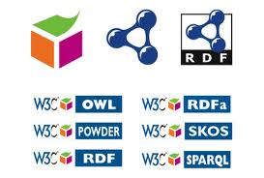
Semantic Web
Semantic Web – web of data, not documents
Machine learning (inferencing) can be enabled via Semantic Web technologies. May use a graph database/triplestore (e.g., Neo4j, Allegrograph, Meronymy)
Bridge the semantic divide (varying vocabularies) with ontologies – helps address the “Variety” aspect of Big Data
Encapsulate data values, metadata, joins, logic, business rules, ontologies, access methods in the data via common logical model (e.g., RDF triples) – very powerful for automation, federated queries

Slide 33
Semantic Web
Find Jane Doe’s relatives (with machine inferencing)
System X
System Y
System Z
a:JoeDoe
:isInLaw
:hasBrother
:hasBrother
x:DebDoe
y:JohnDoe
:marriedTo
z:JaneDoe
:hasBrother
:isInLaw
Original data
Inferred data
Notes:
In this case the properties would have to be associated with rules to describe entailments (i.e., the inferences that can be drawn). These could be encoded using SWRL (Semantic web Rule Language), which also uses RDF.

Slide 34
No One Size Fits All
Many types of solutions will require multiple data paradigms
E.g. Facebook uses MySQL (relational), Hadoop, Cassandra, Hive, etc., for the different types of processing required
Be sure to have a solid use case before deciding to use Big Data / NoSQL technology
Provide solid business and technical justification
Notes:
5/30/2012
34

Slide 35
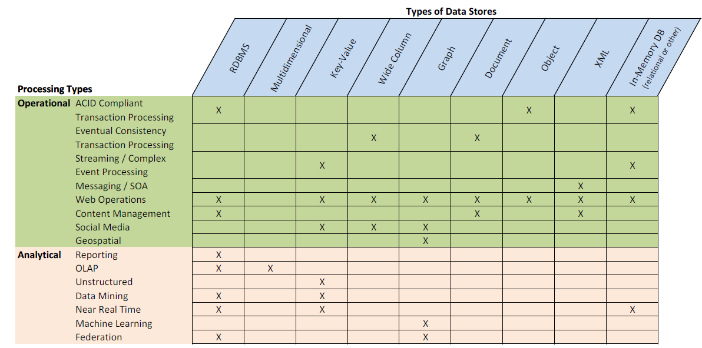
What type of data store to use??
General guidelines…
Notes:
5/30/2012
35

Slide 36
Big Data impact on Application Development and Data Management

Slide 37



ACID / CAP / BASE
If your transaction processing application must be ACID compliant, you must use an RDBMS (or ODBMS)
ACID – Atomic, Consistent, Isolated, Durable
Not all transactions require ACID – eventual consistency may be adequate
Atomic – All tasks in a transaction succeed – or none do
Consistent – Adheres to db rules, no partially completed transactions
Isolated – Transactions can’t see data from other uncommitted transactions
Durable – Committed transaction persists even if system fails
Vs..
Notes:
5/30/2012
37

Slide 38

ACID / CAP / BASE
Brewer’s CAP theorum for distributed database
Consistency, Availability, Partition Tolerance - Pick 2!
For Big Data, BASE is alternative for ACID
Basically Available – data will be available for requests, might not be consistent
Soft state – due to eventual consistency, the system might be continually changing
Eventually consistent – the system will eventually be consistent when input stops
Example: HBase every transaction will execute, but only the most recent for a key will persist (LILO – last in, last out) – no locking
Notes:
5/30/2012
38
Partition tolerance has to do with network partition e.g., two nodes aren’t able to communicate

Slide 39
Data Management
Security not as mature with NoSQL – might use OS level encryption (e.g.,, IBM Guardium Encryption Expert, Gazzanga) - encyrpt/decrypt at IO level
Data Governance needs to oversee Big Data – new knowledge uncovered can lead to risks - privacy, intellectual property, regulatory compliance, etc.
Physical Data Modeling less important – due to “schema-less” nature of NoSQL
Conceptual Modeling still important for understanding business objects and relationships
Semantic modeling – inform ontologies which enable inferencing
Logical Data Modeling still useful for reasoning and communicating about how data will be organized
Due to schema-less nature of NoSQL – metadata management will be more important!
E.g., wide-column store with billions of records and millions of variable columns – useless unless you have the metadata to understand the data
Notes:
5/30/2012
39

Slide 40
Getting started
Data Scientist is a key role in Big Data – requires statistics, data modeling, and programming skills. Not many around and expect to pay $$$’s.
Big Data technologies represent a significant paradigm shift. Be sure to allow budget for training, sandbox environment, etc.
Start small with Big Data ☺. Start with a single use case – allocate significant amount of time for learning curve, and environment setup, testing, tuning, management.
Working with open source software can present challenges. Investigate purchase of value added software for simplification. Tools such as IBM Big Insights, EMC Greenplum UAP (Unified Analytics Platform) adds analytical, administration, workflow, security, and other functionality.

Slide 41
Summary

Slide 42
Summary
Big Data presents significant opportunities
Big Data is distinguished by volume, velocity, and variety
Big Data is not just Hadoop / MapReduce and not just NoSQL
Key enabler for Big Data is Massively Parallel Processing (MPP)
Using commodity hardware and open source software are options to drive down cost of Big Data
Big Data and NoSQL technologies require a learning curve, and will continue to mature
Notes:
5/30/2012
42

Slide 43
Resources
Perficient Healthcare: http://healthcare.perficient.com
Perficient Healthcare IT blog: http://blogs.perficient.com/healthcare/
Perficient Healthcare Twitter: @Perficient_HC
Apache – download and learn more about Hadoop, Cassandra, etc.
http://hadoop.apache.org/
http://cassandra.apache.org/
Comprehensive list with description of NoSQL databases: http://nosql-database.org/links.html
Translational Medicine Ontology (TMO) - applying Semantic Web for personalized medicine: http://www.w3.org/wiki/HCLSIG/PharmaOntology
Notes:
5/30/2012
43

Slide 44
Q & A

Slide 45
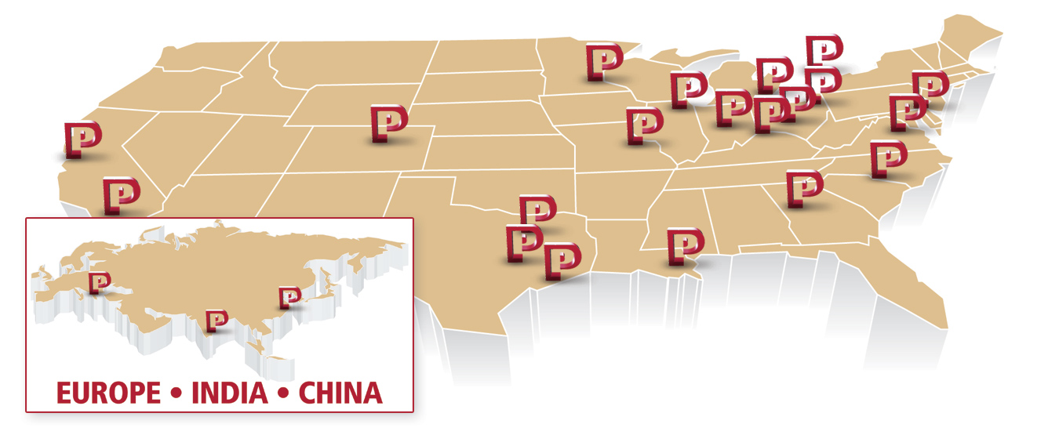

About Perficient
Perficient is a leading information technology consulting firm serving clients throughout North America.
We help clients implement business-driven technology solutions that integrate business processes, improve worker productivity, increase customer loyalty and create a more agile enterprise to better respond to new business opportunities.

Slide 46

PRFT Profile
Founded in 1997
Public, NASDAQ: PRFT
2011 Revenue of $260 million
20 major market locations throughout North America
Atlanta, Austin, Charlotte, Chicago, Cincinnati, Cleveland, Columbus, Dallas, Denver, Detroit, Fairfax, Houston, Indianapolis, Minneapolis, New Orleans, Philadelphia, San Francisco, San Jose, St. Louis and Toronto
1,800+ colleagues
Dedicated solution practices
600+ enterprise clients (2011) and 85% repeat business rate
Alliance partnerships with major technology vendors
Multiple vendor/industry technology and growth awards

Slide 47
Our Solutions Expertise & Services
Business-Driven Solutions
Enterprise Portals
SOA and Business Process Management
Business Intelligence
User-Centered Custom Applications
CRM Solutions
Enterprise Performance Management
Customer Self-Service
eCommerce & Product Information Management
Enterprise Content Management
Industry-Specific Solutions
Mobile Technology
Security Assessments
Perficient Services
End-to-End Solution Delivery
IT Strategic Consulting
IT Architecture Planning
Business Process & Workflow Consulting
Usability and UI Consulting
Custom Application Development
Offshore Development
Package Selection, Implementation and Integration
Architecture & Application Migrations
Education
Perficient brings deep solutions expertise and offers a complete set of flexible services to help clients implement business-driven IT solutions

